Slide 1
CUDA MODE:
Lecture 1
Mark Saroufim

Slide 2
Logistics
Hosts: Andreas Köpf, Thomas Viehmann, Mark Saroufim
1 per 2 week on a CUDA topic: textbook chapter, pair programming session or project
Target audience is torch programmers tired of CUDA tutorial hell
Textbook: Programming Massively Parallel Processors
Additional resources here in resource-stream
All communication will happen on our Discord
Sessions will be recorded on https://www.youtube.com/@CUDAMODE

Slide 3

Goal of Lecture 1
Integrate a CUDA kernel inside a pytorch program
Learn how to profile it
Most of the code is here https://github.com/msaroufim/cudamodelecture1
I believe thing I see

Slide 4
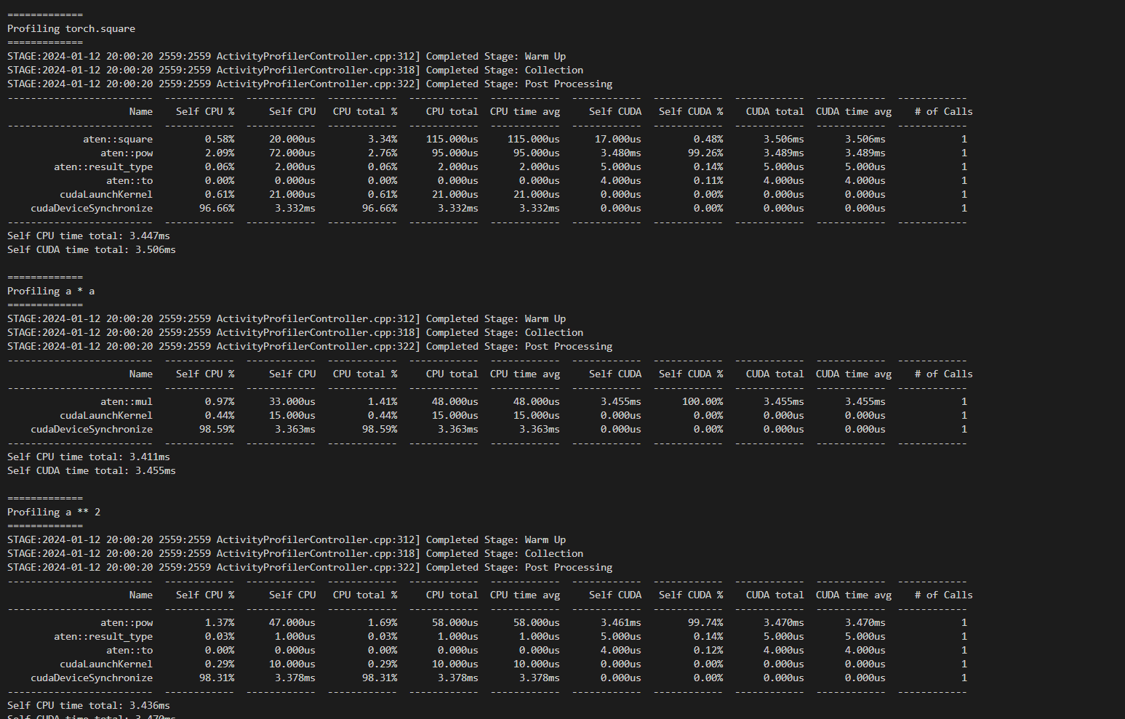
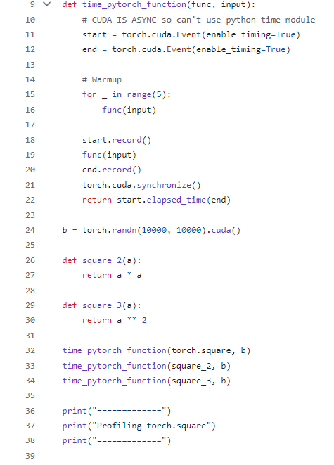
Start with something simple
https://github.com/msaroufim/cudamodelecture1/blob/main/pytorch_square.py

Slide 5
Square function just calls pow (internally)! So, simply using pow is faster
A * A is bit faster compared to A.square(). A*A is also a bit faster compared to A**2!
So, by calling torch.square() -> that calls pow which instantiates a kernel with 4 blocks by default! Can be understood by profiling

Slide 6
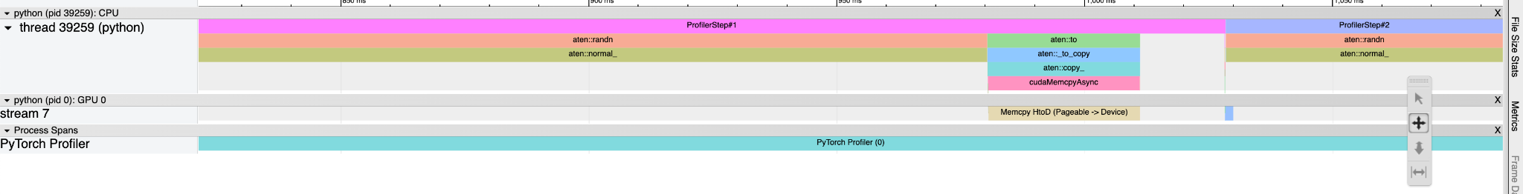
PyTorch profiler
Memcpy HtoD (Pageable -> Device)
- (Memcopy host to device -> Send data to CPU to GPU). This is basically .cuda()
Host to device copy
Pageable memory is on host but can be copied freely in out of RAM
https://github.com/msaroufim/cudamodelecture1/blob/main/pt_profiler.py

Slide 7
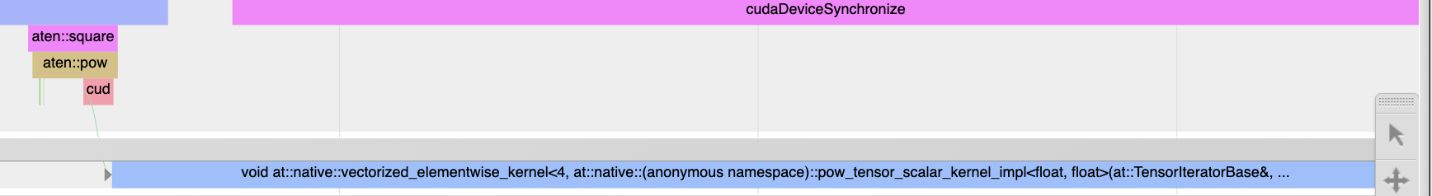
What can we learn?
- Aten::square is a call to aten:pow
- A cuda kernel gets launched called native_vectorized_elementwise_kernel<4, ..>
- 4 is the number of blocks
https://github.com/pytorch/pytorch/blob/main/caffe2/utils/math/elementwise.cu

Slide 8
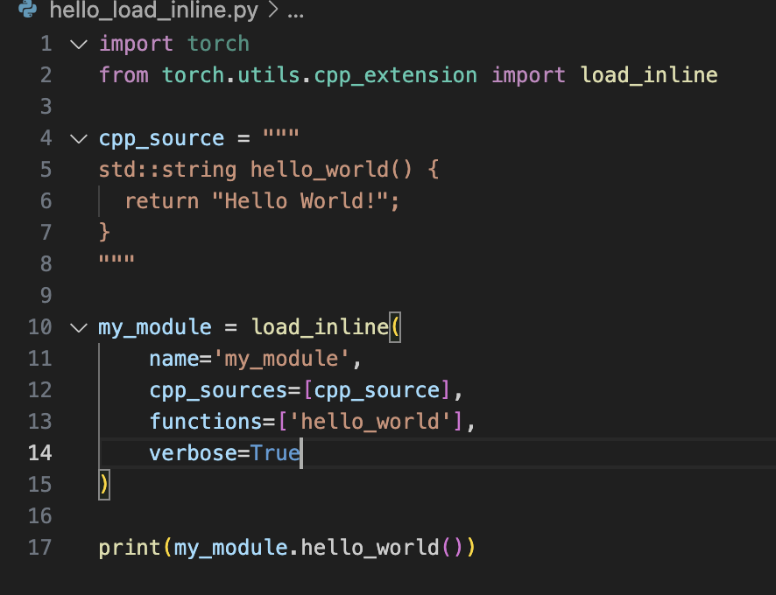
Custom cpp extensions
https://github.com/msaroufim/cudamodelecture1/tree/main/tmp - Under the hood directory that’s getting created!!

Slide 9
Codegen
#include <torch/extension.h>
std::string hello_world() {
return "Hello World!";
}
PYBIND11_MODULE(TORCH_EXTENSION_NAME, m) {
m.def("hello_world", torch::wrap_pybind_function(hello_world), "hello_world");
}

Slide 10
How to run a CUDA kernel from pytorch
https://github.com/msaroufim/cudamodelecture1/blob/main/load_inline.py

Slide 11
numba
https://gist.github.com/msaroufim/6673c9e5c0c3d58740472601eac6d4df

Slide 12
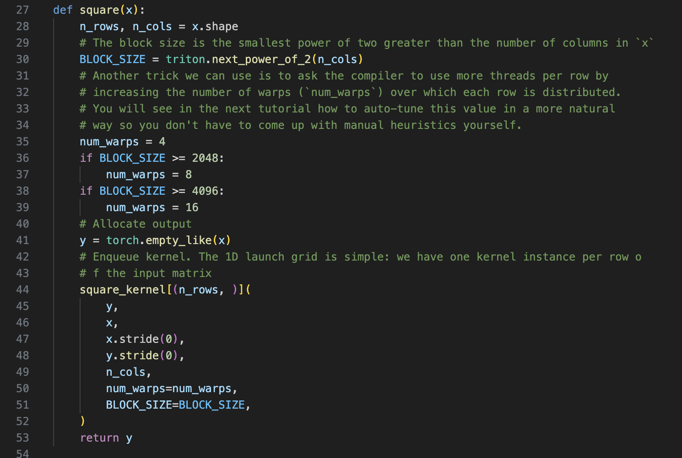
Integrate a triton kernel

Slide 13
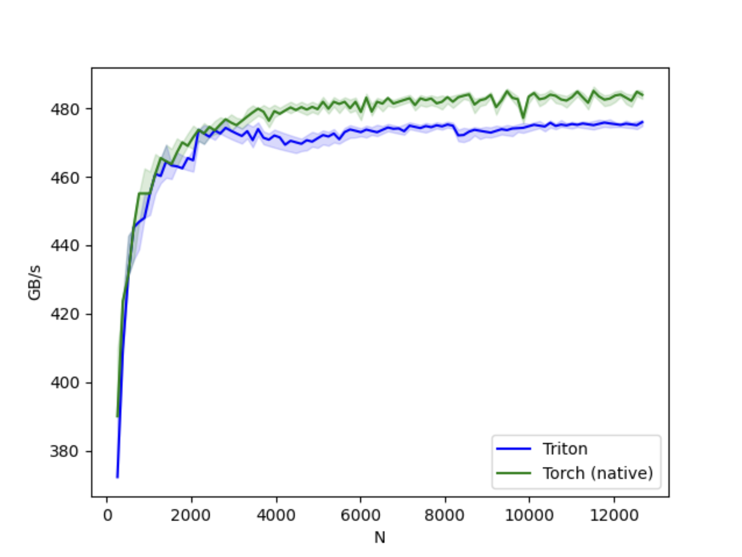
Triton kernel on A10G – This is not expected!
https://gist.github.com/msaroufim/8649307ecdbb9309ced2d5106073bc0c

Slide 14
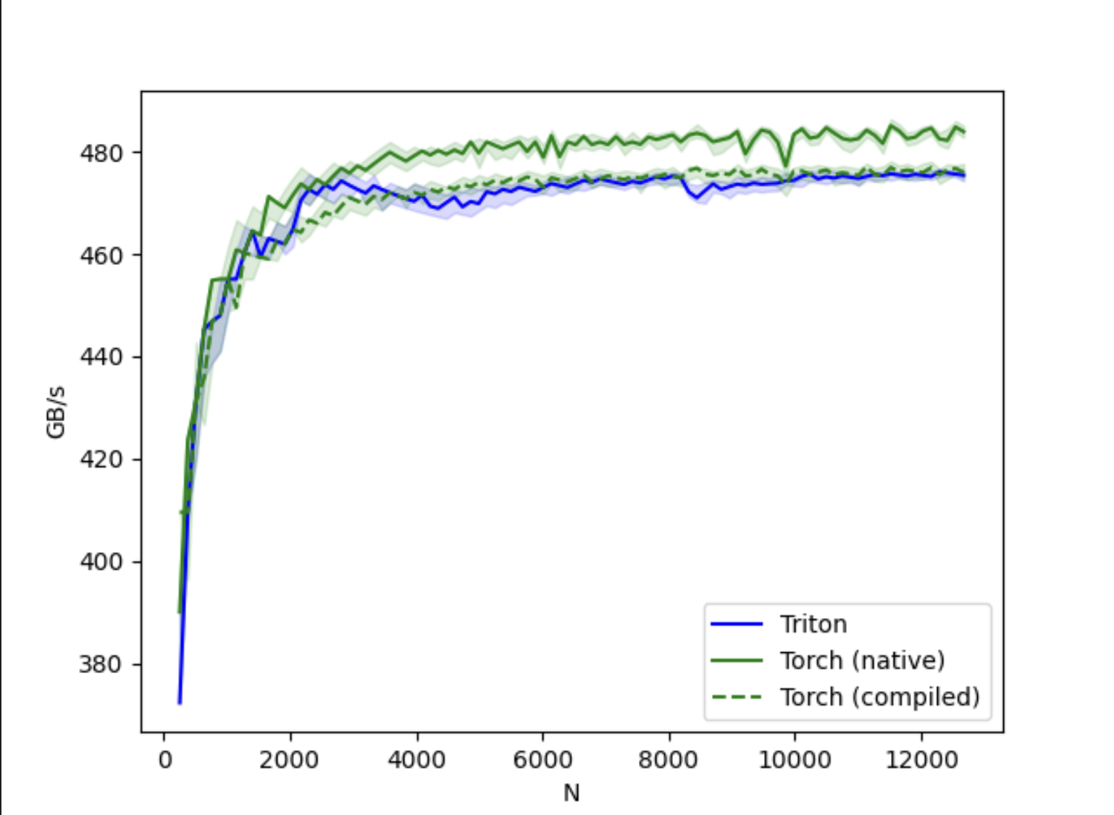
torch.compile

Slide 15
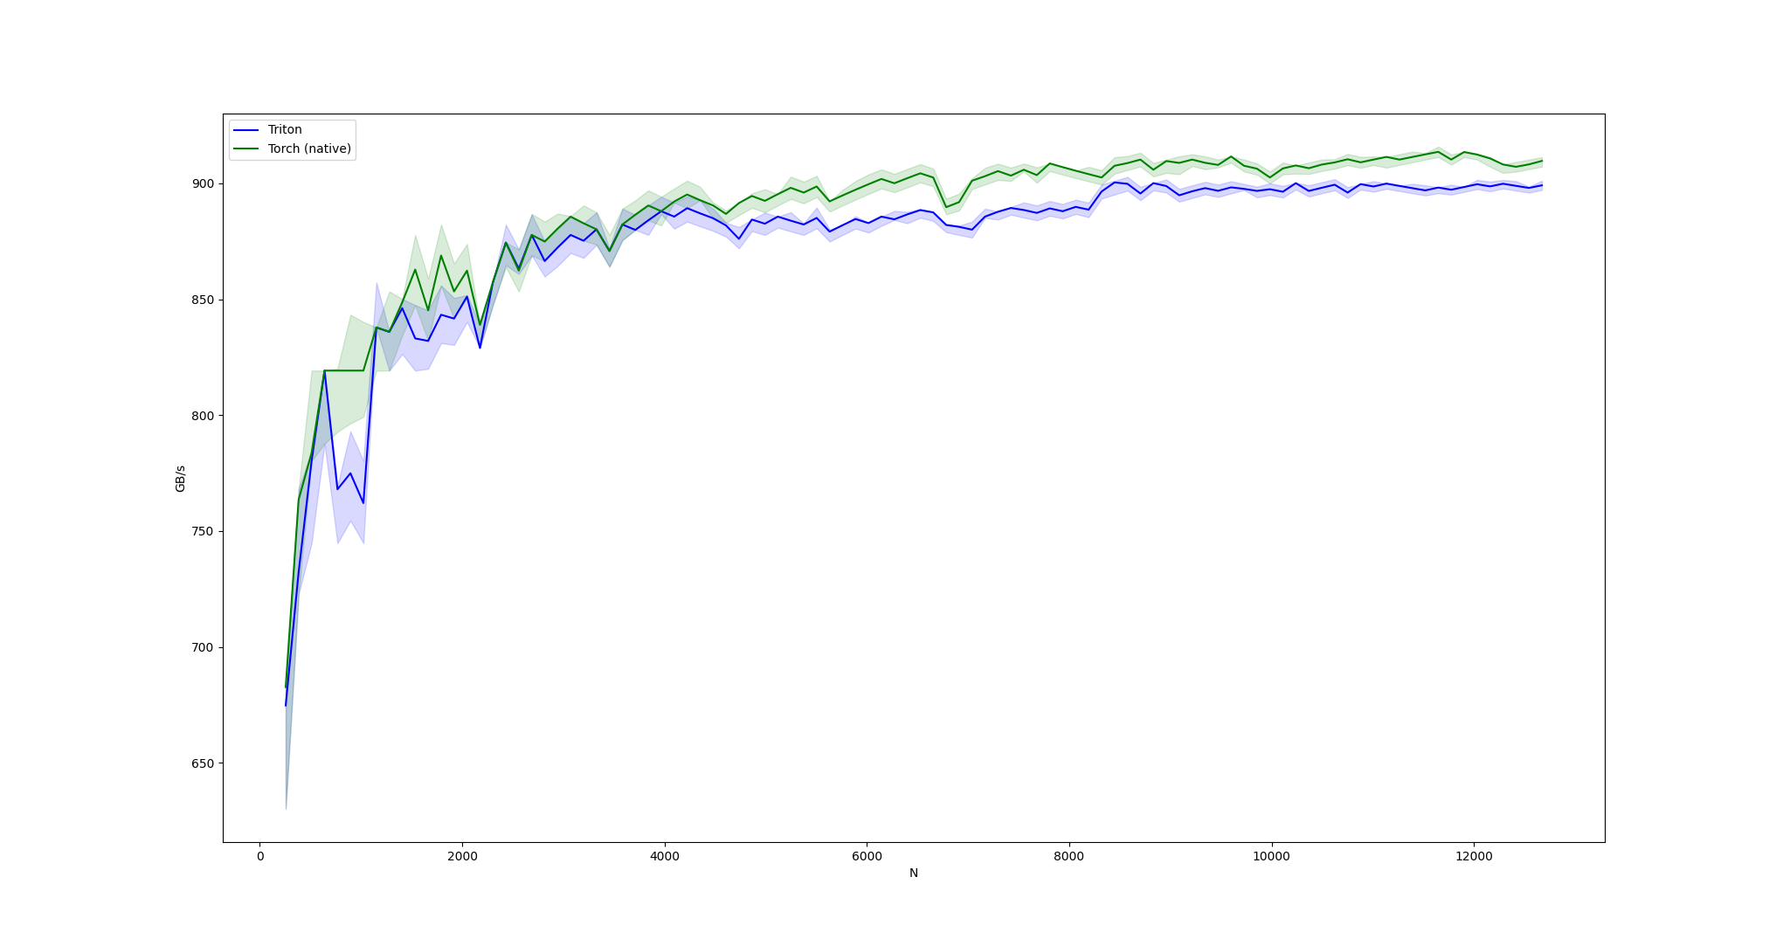
Results on 4090 – Again, triton should be faster!!

Slide 16
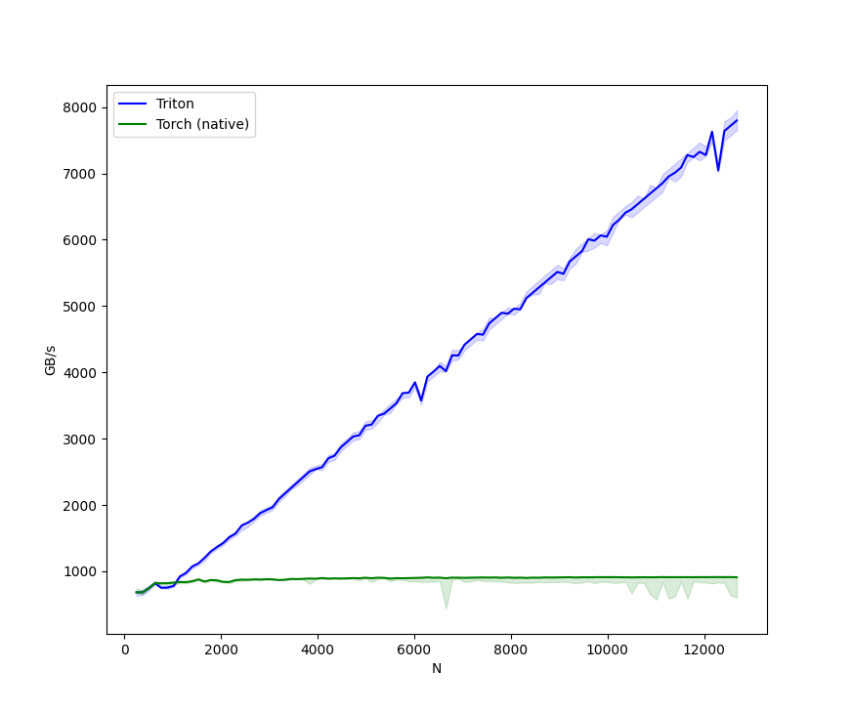
After fixing the block size to 1024

Slide 17
Triton has a debugger now (Use this to debug triton code!)
triton.jit(interpret=True)
Almost everything is a WrappedTensor so inspect variables with var_name.tensor
https://gist.github.com/msaroufim/f849df30687708782e0269c4b42264b1
Because we can’t use print statements in these kernels! -> kernels run on GPU and shared memory and print might not have access to those locations!

Slide 18
Look at PTX
https://github.com/msaroufim/cudamodelecture1/blob/main/square_kernel.ptx
8 registers with a self multiplication for input (f1 till f8 for inputs) and 8 registers for output (f9 till f16)
-
.loc 1 19 26
mul.f32 %f9, %f1, %f1;
mul.f32 %f10, %f2, %f2;
mul.f32 %f11, %f3, %f3;
mul.f32 %f12, %f4, %f4;
mul.f32 %f13, %f5, %f5;
mul.f32 %f14, %f6, %f6;
mul.f32 %f15, %f7, %f7;
mul.f32 %f16, %f8, %f8;

Slide 19
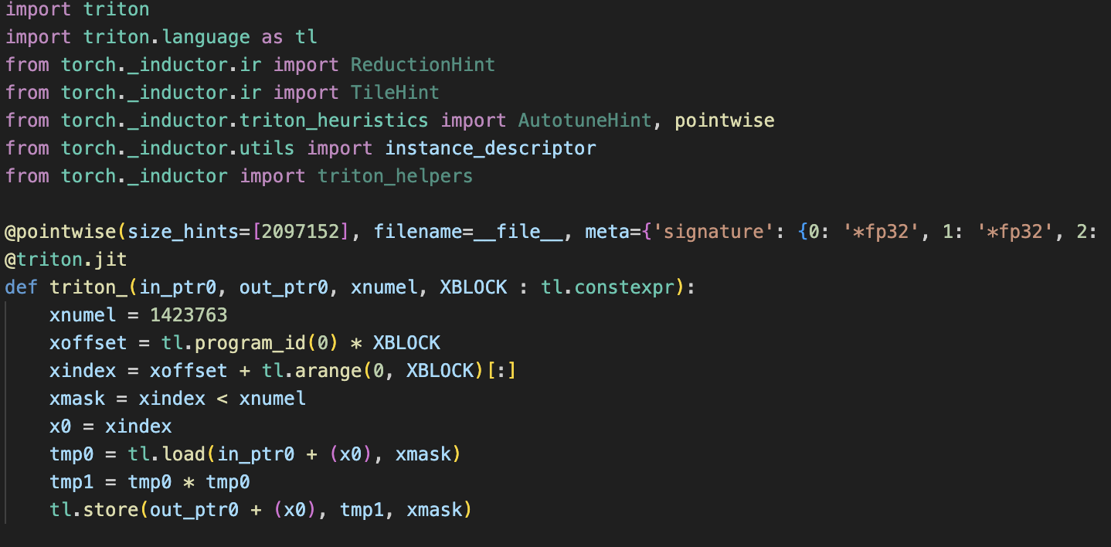
Cheat: Generate a triton kernel
Instead of writing triton kernel from scratch, have the code ready and call
TORCH_LOGS="output_code" python compile_square.py
So, the code - torch.compile(torch.square)) generates the triton kernels we can see and learn!

Slide 20
ncu profiler
ncu python train.py
ncu --set full -o output $(which python) train.py
https://github.com/msaroufim/cudamodelecture1/blob/main/ncu_logs
Contains actionable hints like
OPT This kernel grid is too small to fill the available resources on this device, resulting in only 0.4 full waves across all SMs. Look at Launch Statistics for more details.

Slide 21
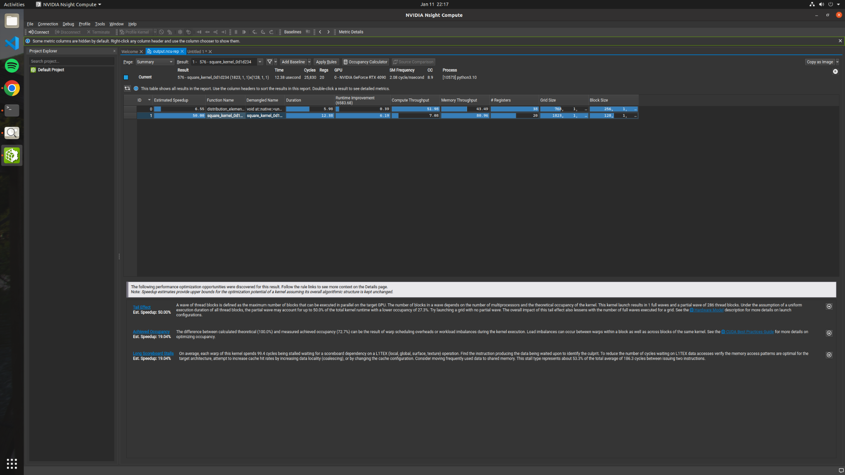

Slide 22
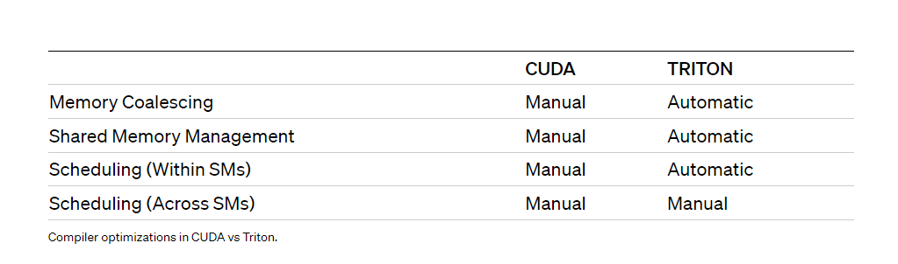
Zoom in
Tail effect + Achieved occupancy 70%: Try padding (We can control)
Long scoreboard stalls: coalesce, use shared memory (Controlled by Triton :( )

Slide 23
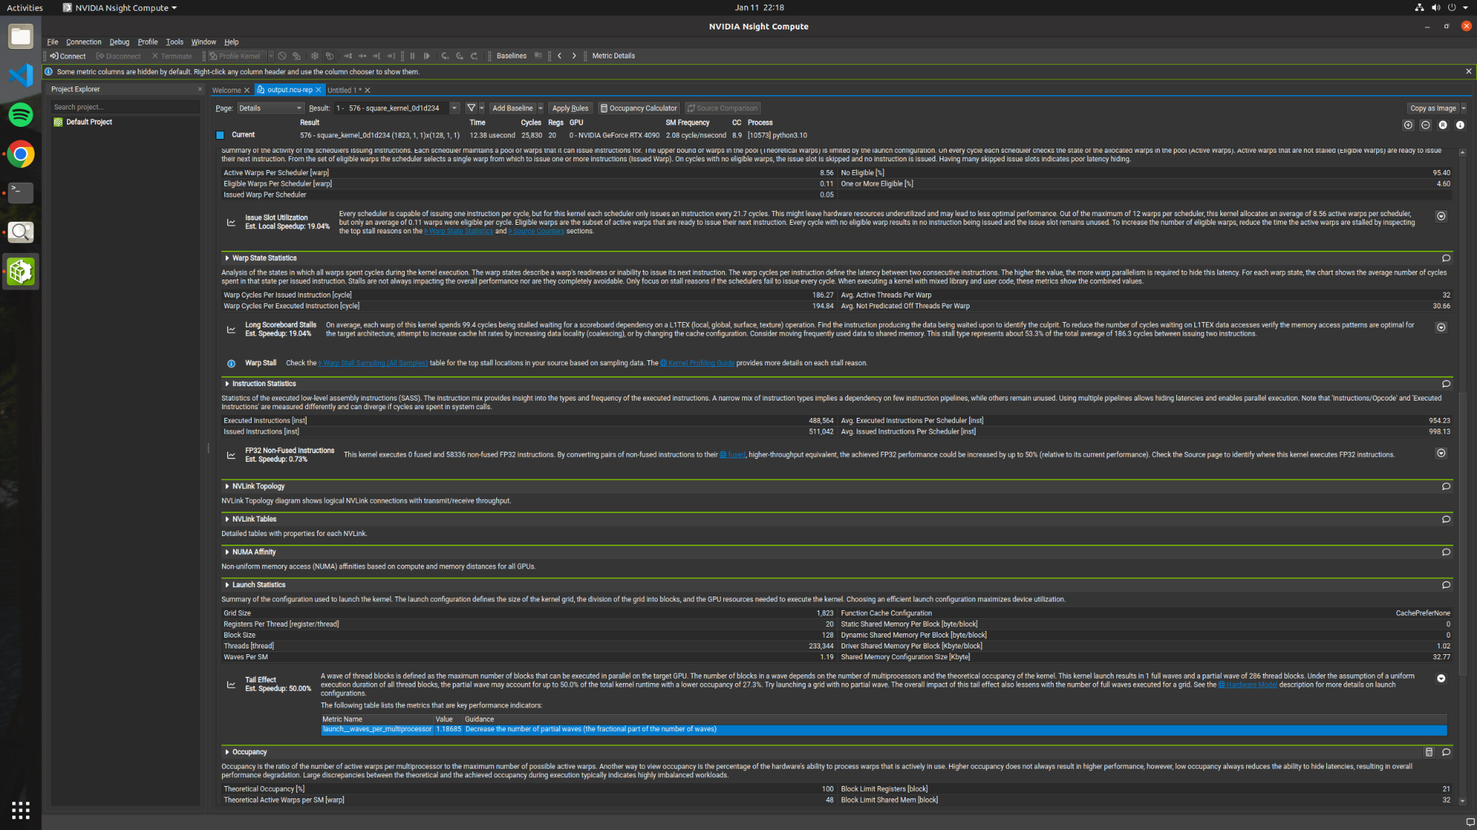

Slide 24
